Slide 1




The course notes are partly based on the Machine learning course presented by Andrew Ng at Stanford University and the original can be found at https://www.coursera.org/course/ml b
e.
All materials without annotations or marks are copyrighted by their copyright owner.
All the codes and modified slides are available at Github & OSChina
The project homepage:
https://github.com/sunzuolei/ml
https://git.oschina.net/samuel/ml
The Git repository:
https://github.com/sunzuolei/ml.git
https://git.oschina.net/samuel/ml.git

Slide 2
Supervised learning
Regression
Classification
Continuous output
Discrete output
Unsupervised learning

Slide 3

Classification
Logistic
Regression
Machine Learning

Slide 4
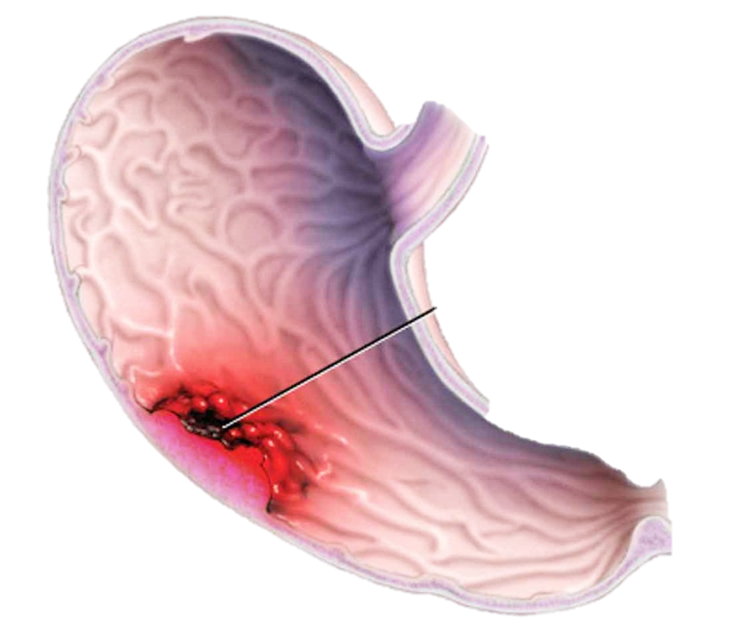
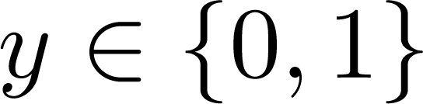
Classification
Email: Spam / Not Spam?
Online Transactions: Fraudulent (Yes / No)?
Tumor: Malignant / Benign ?
0: “Negative Class” (e.g., benign tumor)
1: “Positive Class” (e.g., malignant tumor)

Slide 5


(Yes) 1
Malignant ?
(No) 0
Tumor Size
Can we apply the linear regression to this data set?

Slide 6
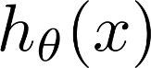
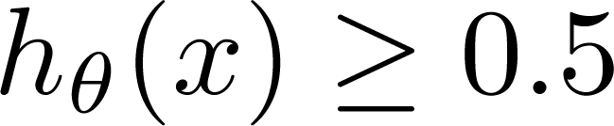
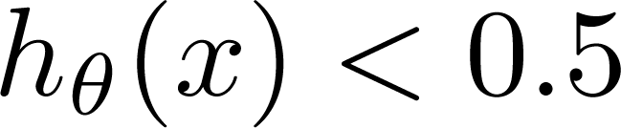
(Yes) 1
Malignant ?
(No) 0
Tumor Size
Tumor Size
Threshold classifier output at 0.5:
If , predict “y = 1”
If , predict “y = 0”

Slide 7
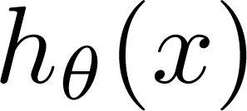
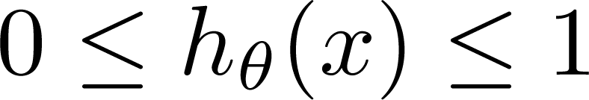
Classification: y = 0 or 1
can be > 1 or < 0
Logistic Regression:

Slide 8
Hypothesis Representation
Logistic
Regression
Machine Learning

Slide 9
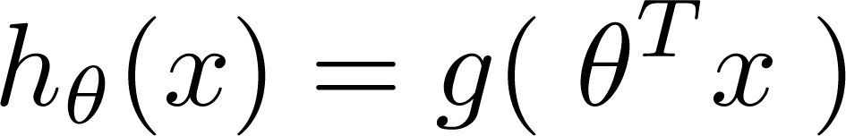
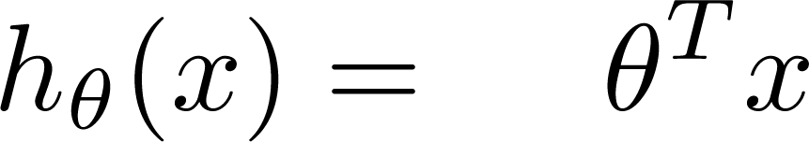
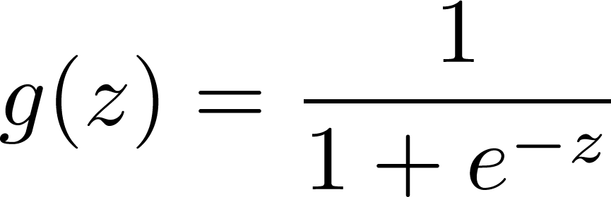
P11
Logistic Regression Model
Want
1
0.5
Sigmoid function
Logistic function
0
Let’s implement the Sigmoid function!

Slide 10
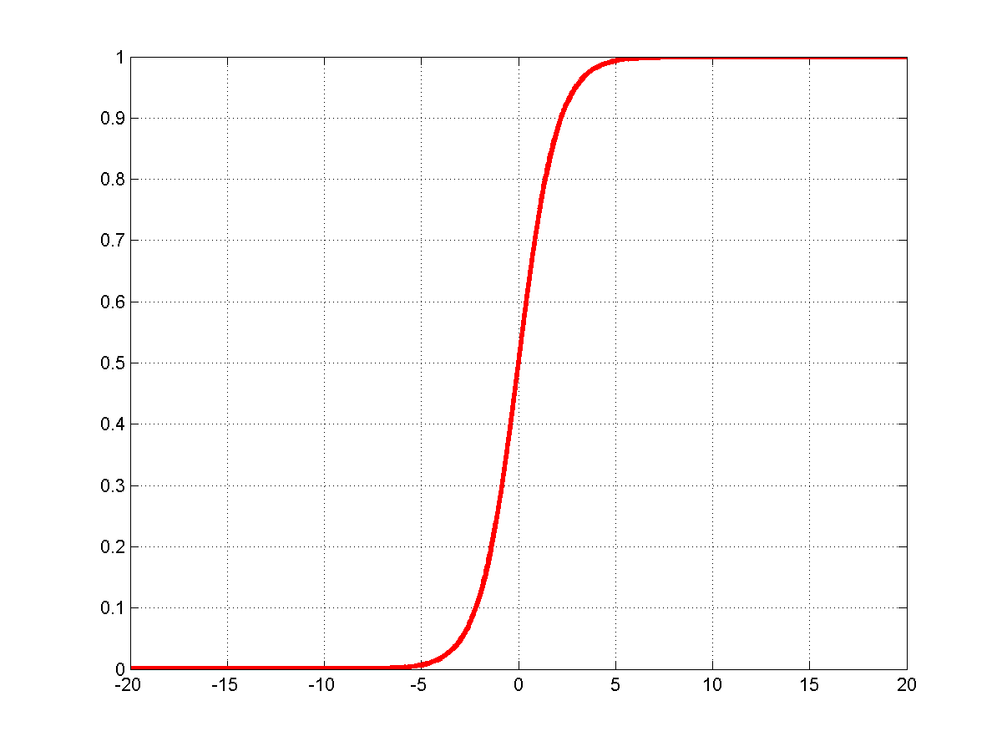
1
0.5

Slide 11
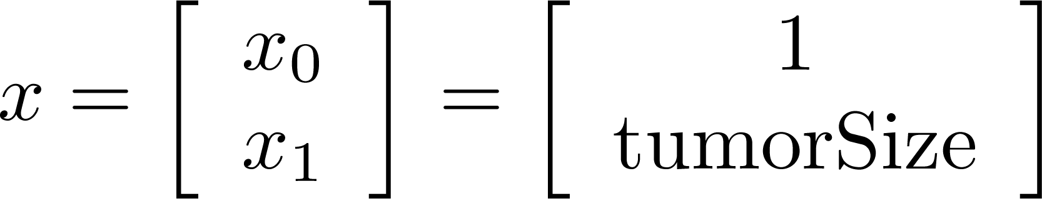
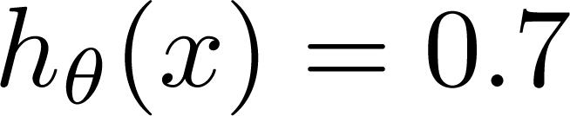
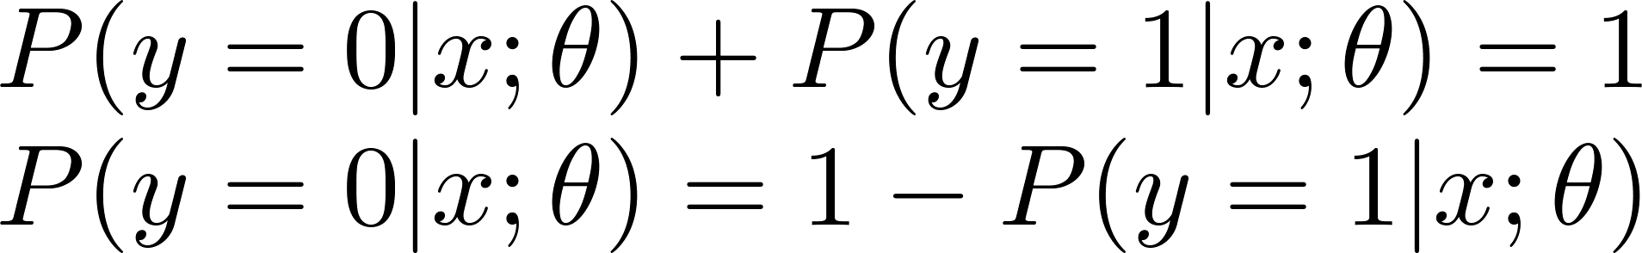
Interpretation of Hypothesis Output
= estimated probability that y = 1 on input x
Example: If
Tell patient that 70% chance of tumor being malignant
“probability that y = 1, given x,
parameterized by ”

Slide 12
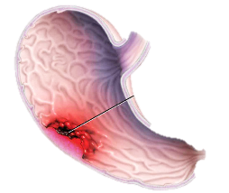
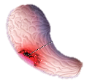

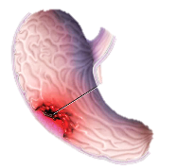

P12
Let’s visualize the cancer data!

Slide 13
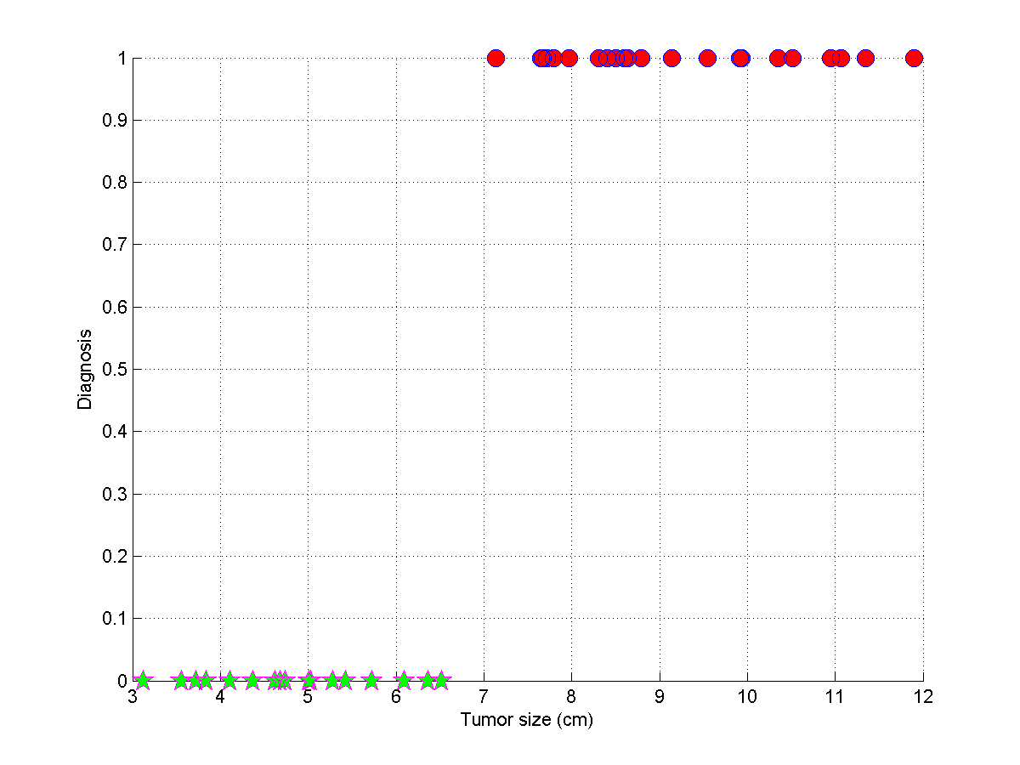



Slide 14
Decision boundary
Logistic
Regression
Machine Learning

Slide 15
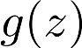
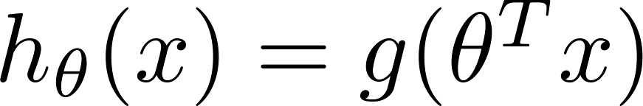
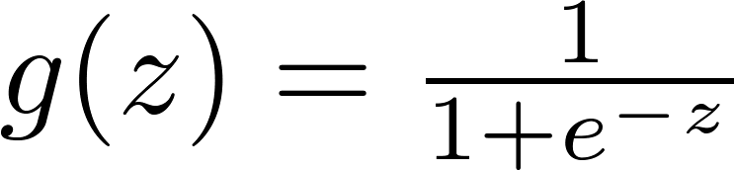
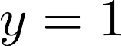
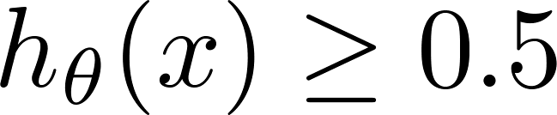
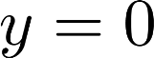
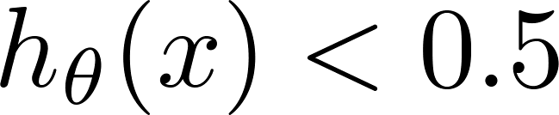
Logistic regression
1
z
Suppose predict “ “ if
predict “ “ if

Slide 17
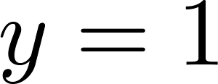
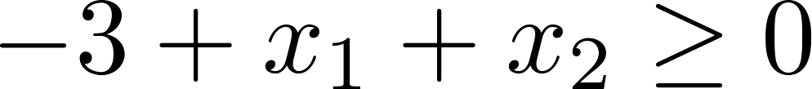
Decision Boundary
x₂
3
2
1
1
2
3
x₁
Predict “ “ if

Slide 18
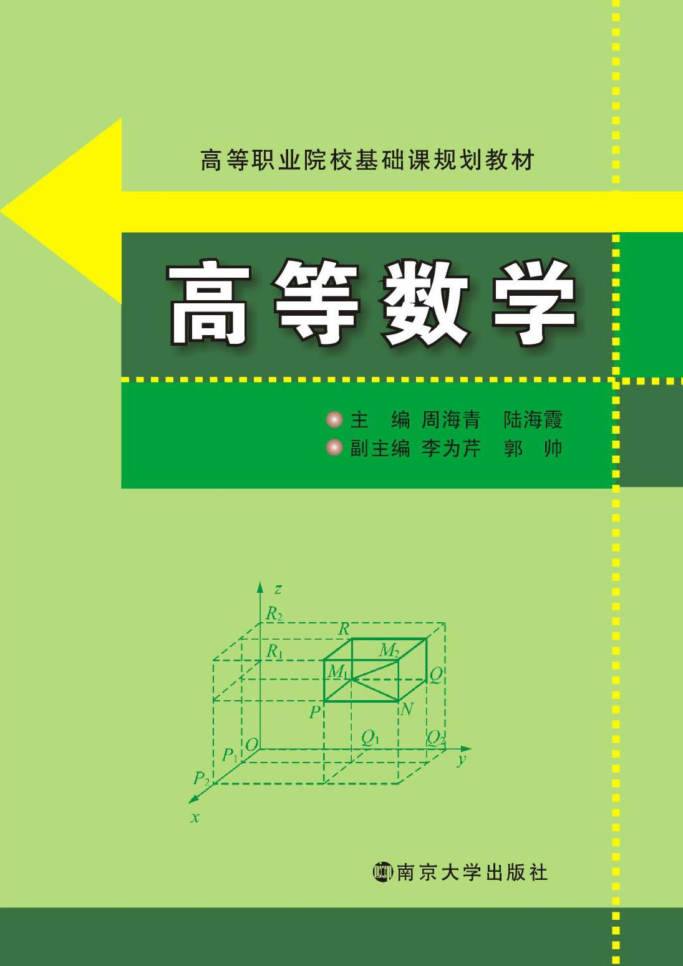


Determine the admission based on two exams.
P13
Let’s visualize the exams data!

Slide 19
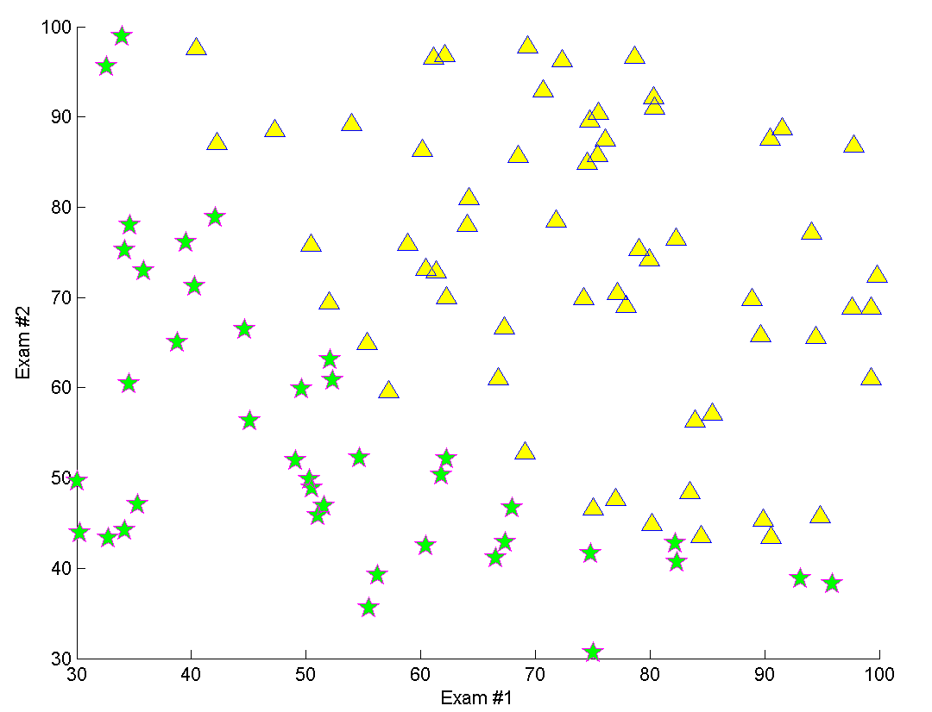
P13

Slide 20
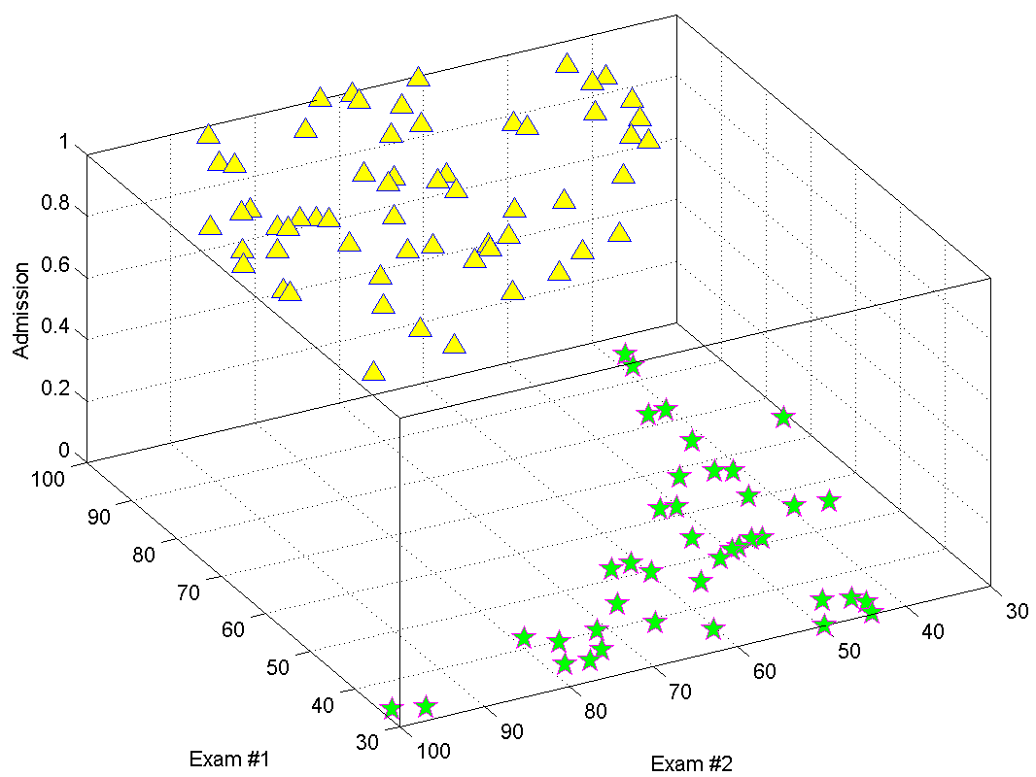
P13

Slide 21
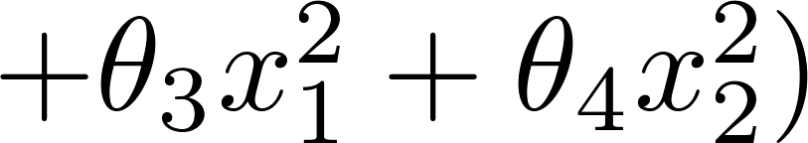
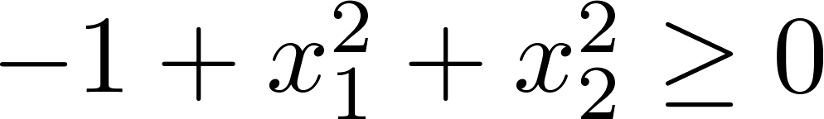
Non-linear decision boundaries
x₂
1
x₁
-1
1
-1
Predict “ “ if
x₂
x₁

Slide 22

Microchip Quality Assurance (QA): During QA, each microchip goes through various tests to ensure it is functioning correctly.
P14
Let’s visualize the QA data!

Slide 23
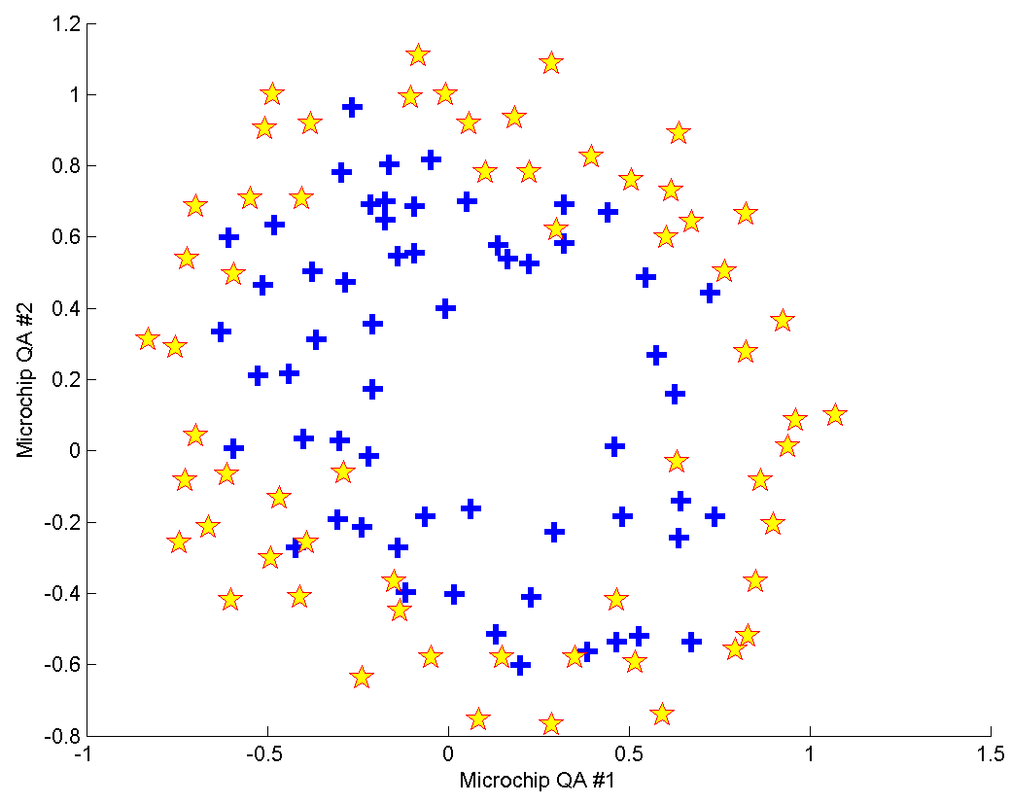
P14

Slide 24
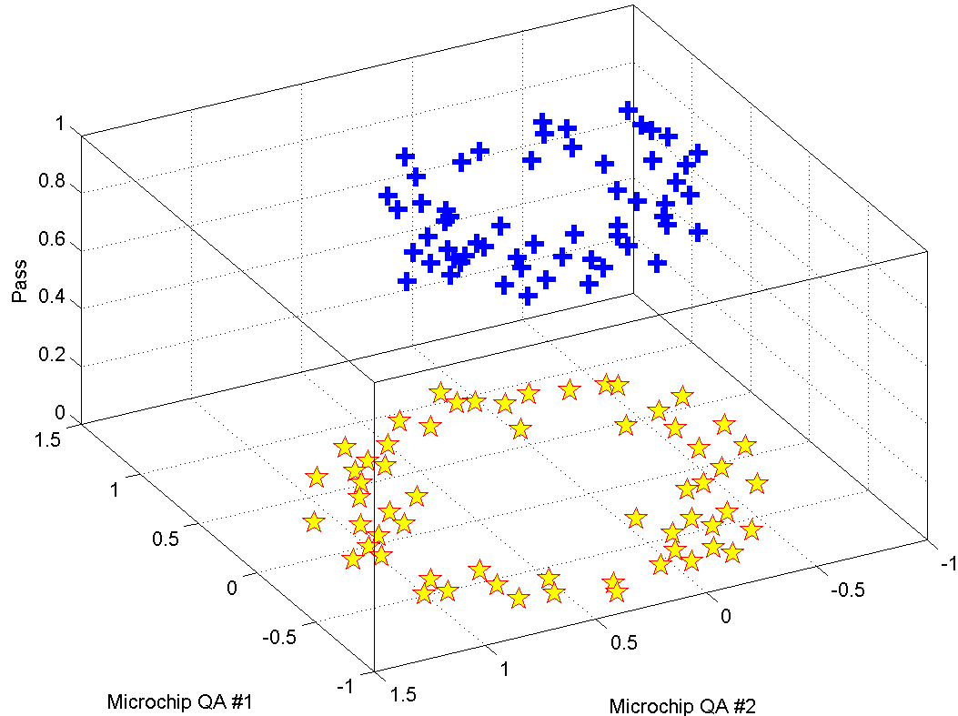
P14

Slide 25
Cost function
Logistic
Regression
Machine Learning

Slide 26
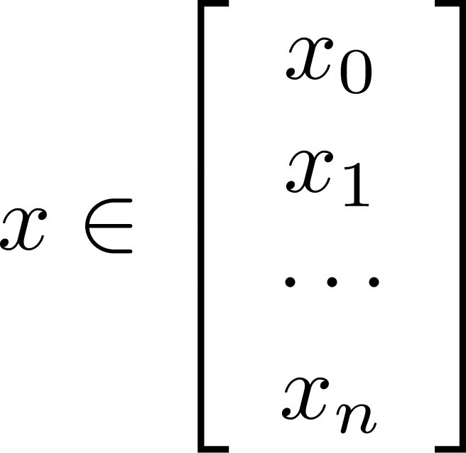
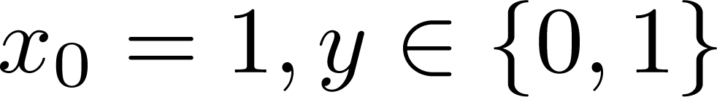
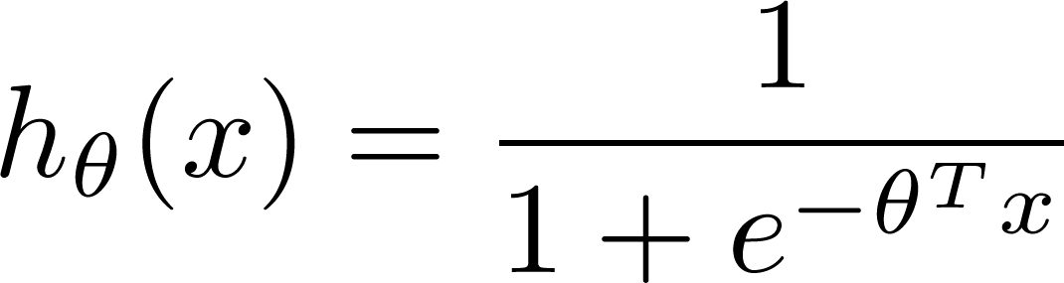

Training set:
m examples
How to choose parameters ?

Slide 27
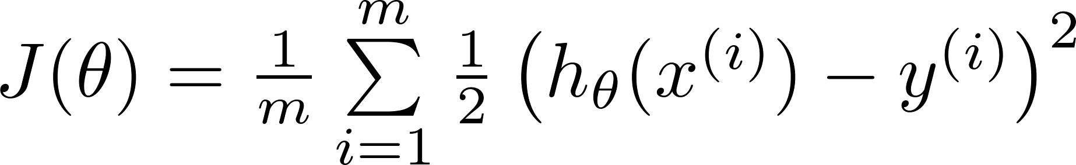
Cost function
Linear regression:
Logistic regression:
P15
Let’s visualize the cost function of a logistic regression with cancer data!

Slide 28
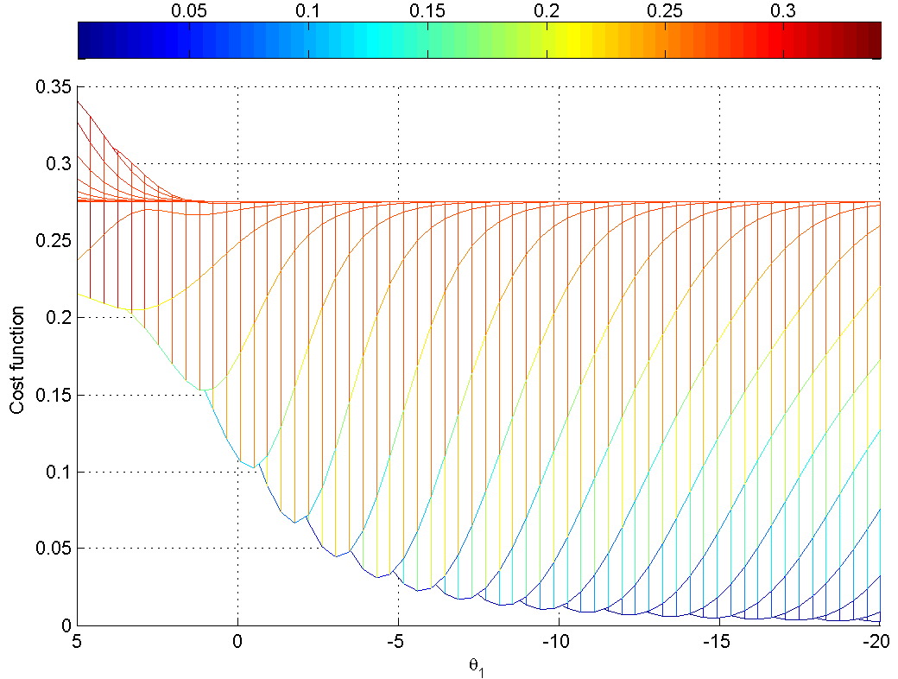
P15

Slide 29
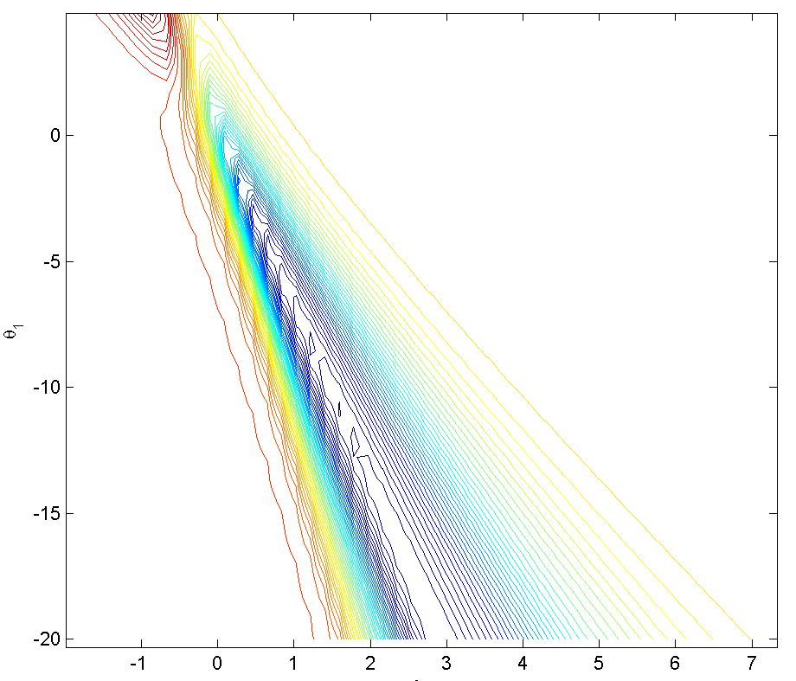
P15

Slide 30


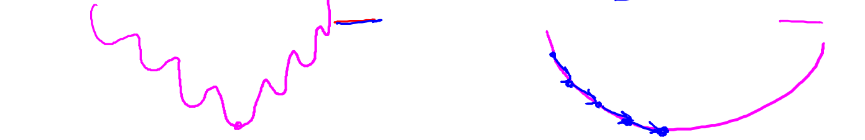
“non-convex”
“convex”

Slide 31
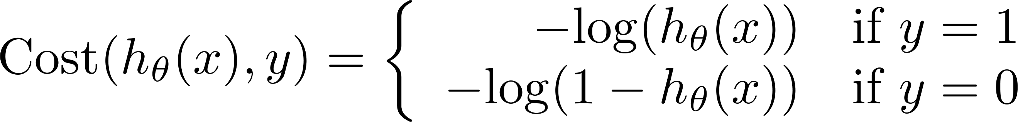
Logistic regression cost function
P16
Let’s visualize the function log(h)!

Slide 32
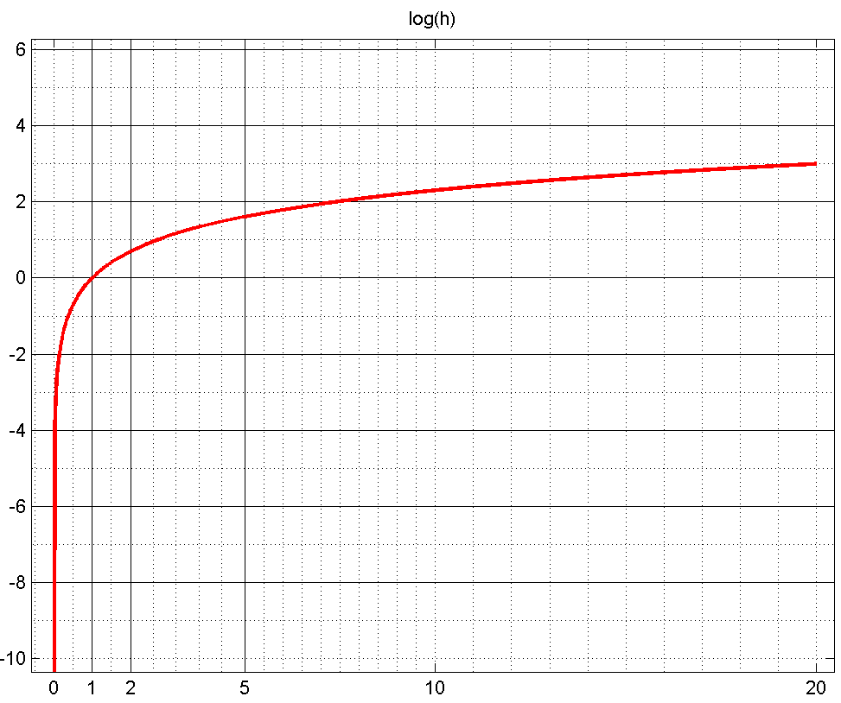
P16

Slide 33
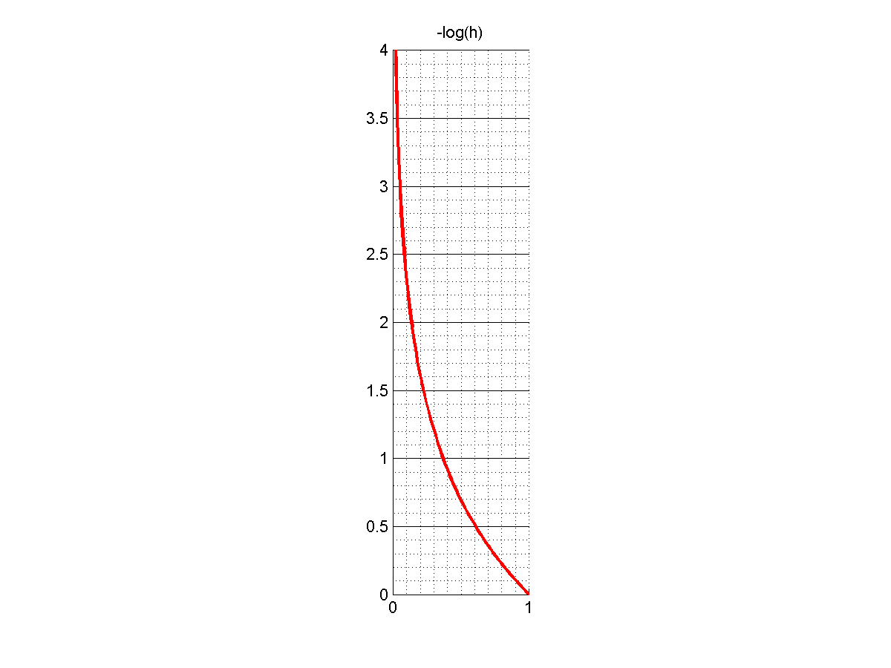
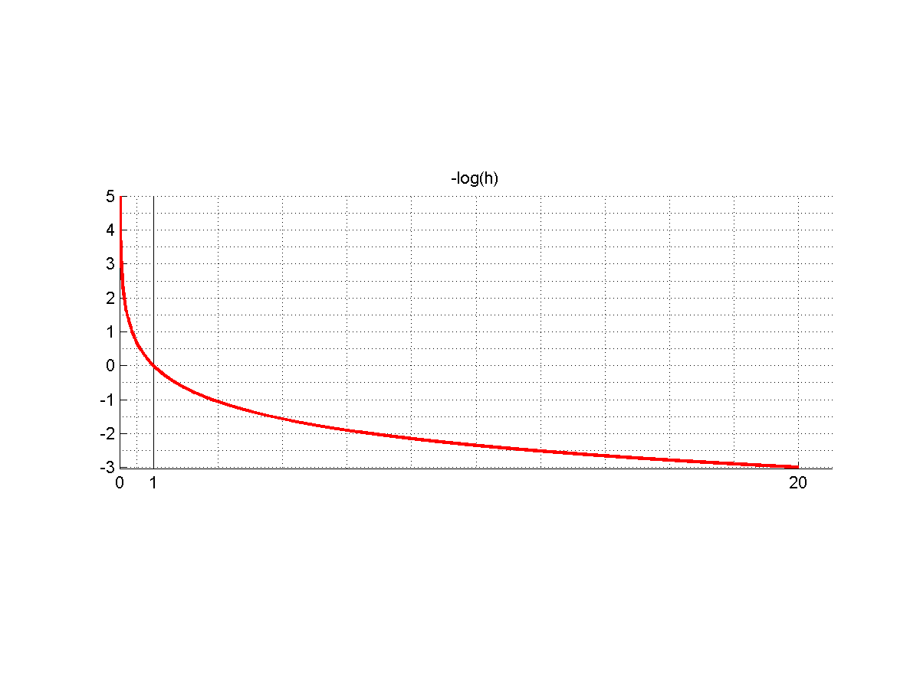
P16

Slide 34
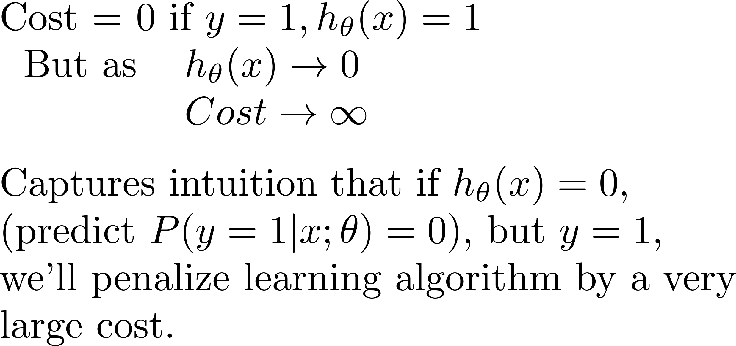
Logistic regression cost function

Slide 35
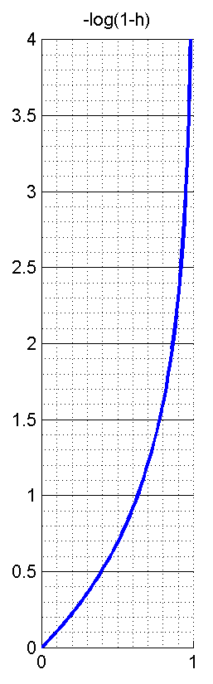
Logistic regression cost function

Slide 36
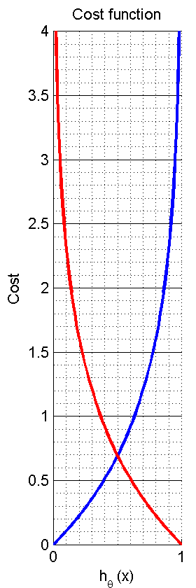
Logistic regression cost function
P16

Slide 37
Simplified cost function and gradient descent
Logistic
Regression
Machine Learning

Slide 38
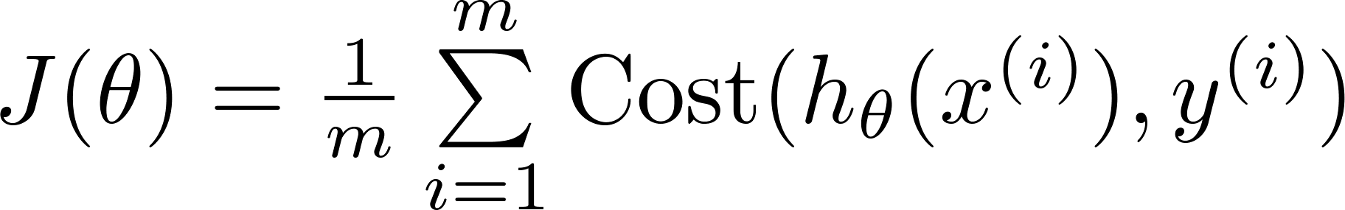


Logistic regression cost function
Let’s visualize it!
P20

Slide 39
P15

Slide 40
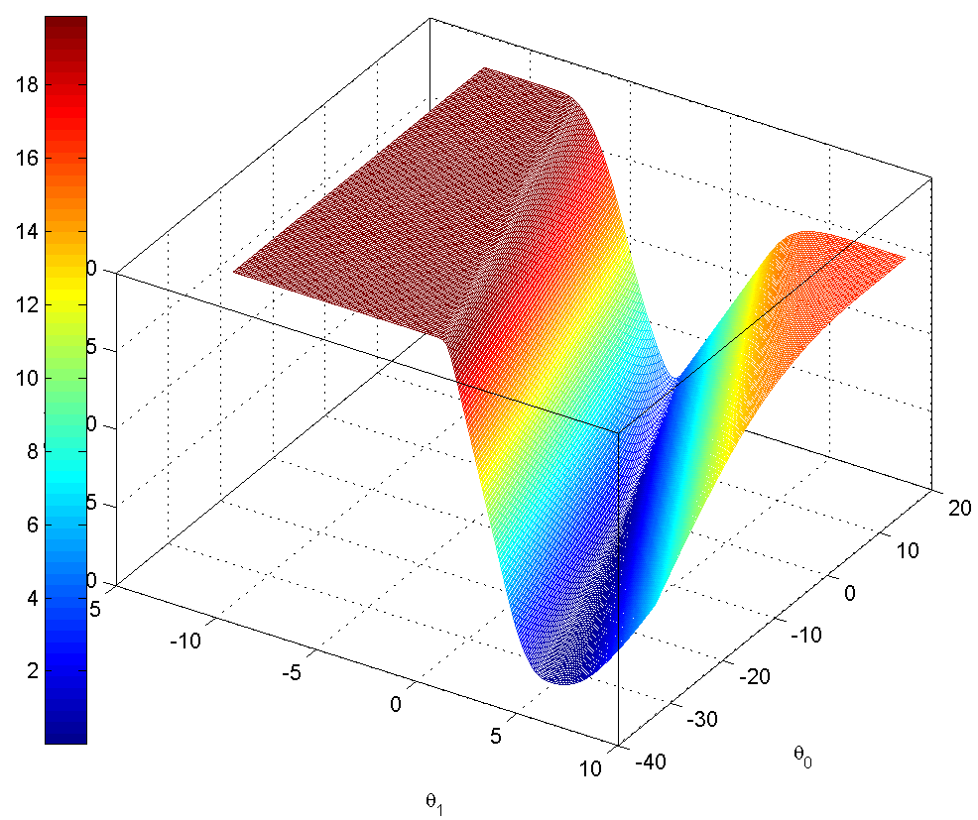
P20

Slide 41

P20

Slide 42





Logistic regression cost function
To fit parameters :
To make a prediction given new :
Output

Slide 43






cost
Gradient Descent
Want :
Repeat
(simultaneously update all )

Slide 44


cost
Gradient Descent
1st
P17
2nd
Let’s derive by programming!
3rd

Slide 45

Gradient Descent
Want :
NO
Repeat
(simultaneously update all )
Is it identical to linear regression?

Slide 46
Gradient Descent
Want :
Repeat
(simultaneously update all )
Is it identical to linear regression?

Slide 47
P18
Let’s implement the logistic regression!

Slide 48

P18

Slide 49
Model Accuracy
%% Compute accuracy on our training set
p = predictLogReg(optTheta, X(:, 2:end));
fprintf('Train Accuracy: %.2f%%\n', …
mean(double(p == y)) * 100);

Slide 50





How to plot the decision boundary?
1
0.5

Slide 51


Slide 52
P19

Slide 53

alpha = 0.01;
numIter = 8000;
P19

Slide 54

alpha = 0.001;
numIter = 8000;
P19

Slide 55

alpha = 0.0008;
numIter = 30000000;
P19

Slide 56

How to plot the decision boundary?
1
0.5

Slide 57

P19

Slide 58

It is slow and hard to tune.
We need more powerful optimization algorithm.

Slide 59
Advanced optimization
Logistic
Regression
Machine Learning

Slide 60



Optimization algorithm
Cost function . Want .
Given , we have code that can compute
(for )
Gradient descent:
Repeat

Slide 61

Optimization algorithm
Given , we have code that can compute
(for )
Optimization algorithms:
Gradient descent
Advantages:
No need to manually pick
Often faster than gradient descent.
Disadvantages:
More complex
Conjugate gradient
BFGS
L-BFGS

Slide 62


Slide 63



Example:
function [jVal, gradient] = costFunction(theta)
jVal = (theta(1)-5)^2 + ... (theta(2)-5)^2;
gradient = zeros(2,1);
gradient(1) = 2*(theta(1)-5); gradient(2) = 2*(theta(2)-5);
options = optimoptions(@fminunc, 'GradObj', 'on', 'MaxIter', 400);
options = optimset(‘GradObj’, ‘on’, ‘MaxIter’, ‘100’);
initialTheta = zeros(2,1); [optTheta, functionVal, exitFlag] ...
= fminunc(@costFunction, initialTheta, options);

Slide 64




theta =
function [jVal, gradient] = costFunction(theta)
code to compute
jVal = [ ];
code to compute
gradient(1) = [ ];
code to compute
gradient(2) = [ ];
code to compute
gradient(n+1) = [ ];

Slide 65
P21
Classify exam data with build-in optimization functions.
P22
Classify cancer data with build-in optimization functions.

Slide 66
Multi-class classification: One-vs-all
Logistic
Regression
Machine Learning

Slide 67
Multiclass classification
Email foldering/tagging: Work, Friends, Family, Hobby
Medical diagrams: Not ill, Cold, Flu
Weather: Sunny, Cloudy, Rain, Snow

Slide 68
Binary classification:
Multi-class classification:
x₂
x₂
x₁
x₁

Slide 69


x₂
One-vs-all (one-vs-rest):
x₁
x₂
x₂
x₁
x₁
Class 1:
Class 2:
Class 3:
x₂
x₁

Slide 70
Recognize
handwritten
digits
It is a subset of the MNIST handwritten digit dataset (http://yann.lecun.com/exdb/mnist/)
Yann LeCun,
Courant Institute, NYU
Corinna Cortes,
Google Labs, New York
Christopher J.C. Burges,
Microsoft Research, Redmond

Slide 71


1 * 400 Pixels
P28
20 * 20 Pixels

Slide 72

P28

Slide 74
Classify the specified digit with logistic regression.
P29

Slide 75
1 | 2 | 3 | 4 | 5 | 6 | 7 | 8 | 9 | 0
1 | 2 | 3 | 4 | 5 | 6 | 7 | 8 | 9 | 10
0 | 0 | 0 | 0 | 0 | 0 | 0 | 1 | 0 | 0

Slide 76


Slide 77


Slide 78



One-vs-all Training
Train a logistic regression classifier for each class to predict the probability that .
for i = 1 : 10
optThetaAll(:, i) = ...
fmincg(@(t)(computeCostLog( xTrain, yTrain == i , t)),...
initTheta, options);
end

Slide 79


One-vs-all Training
Train a logistic regression classifier for each class to predict the probability that .
1
2
10

Slide 80

One-vs-all Inferring
On a new input , to make a prediction, pick the class that maximizes
[decTestPro, decTestAll] = max( sigmoid(xTest * optThetaAll), [], 2 );
1
2
3
4
5
6
7
8
9
10
1
2
3
4
5
6
7
8
9
10
1
2
3
4
5
6
7
8
9
10
1
2
3
4
5
6
7
8
9
10

Slide 81
Classify the digit with One-vs-All logistic regression.
P30

Slide 82


Slide 83
Elapsed time is 9.709350 seconds.
Train Accuracy (based on training data): 96.37%
Train Accuracy (based on test data): 91.00%
rng(666)
Elapsed time is 8.974104 seconds.
Train Accuracy (based on training data): 96.63%
Train Accuracy (based on test data): 88.00%
rng(531)
Elapsed time is 8.843744 seconds.
Train Accuracy (based on training data): 96.43%
Train Accuracy (based on test data): 86.00%
rng(742)
Elapsed time is 10.552962 seconds.
Train Accuracy (based on training data): 96.47%
Train Accuracy (based on test data): 89.00%
rng(38)

